Slide 1
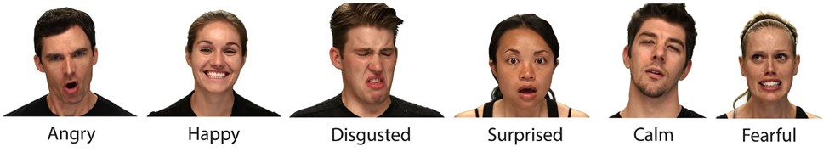
Speech emotion recognition
Presented by: Saurav Dubey (300304233)

Slide 2
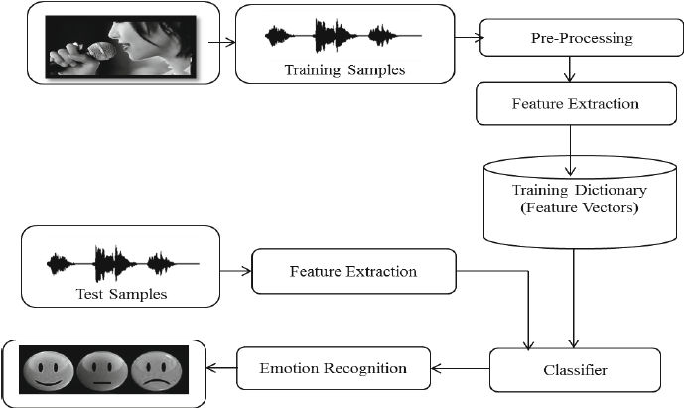
Statement of the Problem
SER
Purpose of Project
Significance
Machine Learning Design Architecture

Slide 3
Plan to develop the project
Technologies:
Python Libraries: pandas, numpy, librosa, sndfile
AWS cloud9 Ubuntu environment
Data Analytics: Exploratory, Classification(MLP Classifier)
Dataset: RAVDESS Emotional song audio
Project Walkthrough

Slide 4

Thank you

